Slide 1
Particle Detection Application
Version 1.0
June 2024
Developed By:
Kyle Bricker, Guilherme M. Bessa, Yeganeh Saffar, Sina Kashanj, Reza Sabbagh,
and
David S. Nobes
University of Alberta, Department of Mechanical Engineering, Edmonton, Canada

Slide 2
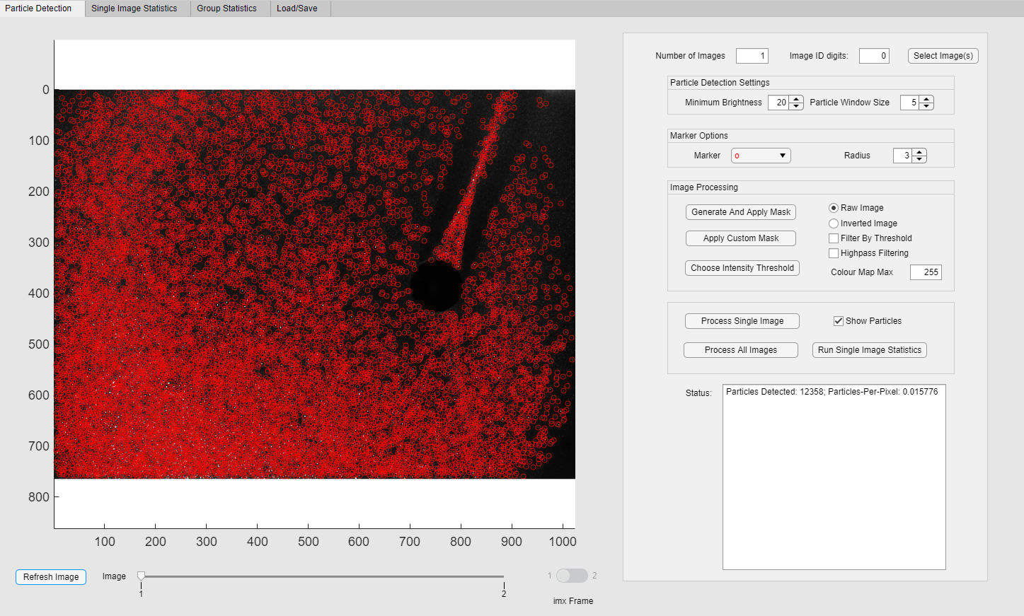
Particle Detection Tab
This tab will be used to select images, preprocess them, and run the main code to detect particles.
At the bottom left there is a slider to switch between loaded images, as well as a switch dedicated to the different frames of *.im7 images.

Slide 3
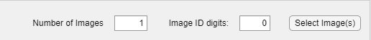
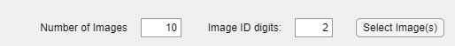
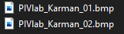
Selecting Images
Fill in the number of total images to select, and the number of ID digits.
The images to the left have 2 image ID digits.
Pressing Select Image(s):
Opens a file explorer window.
Select the first image from the set.
Note: The images must be labelled in ascending order with numerical spacing of 1.
xxxx_01.bmp -> xxxx_02.bmp is good.
xxxx_01.bmp -> xxxx_03.bmp will not work.

Slide 4
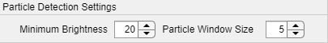
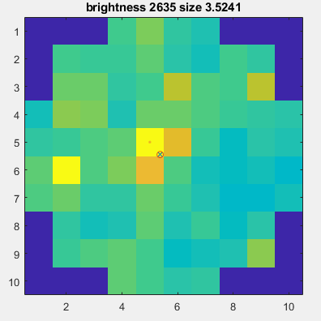
Particle Detection Settings
Minimum Brightness:
The minimum brightness of a pixel that has potential to be a local maxima.
Larger: Will miss some particles, will run faster.
Smaller: Will find more particles, will run slower.
Particle Window Size:
Must be an odd number.
Only one particle can be detected within each window.
A larger particle window will result in fewer particles detected.
Creates a window around the maxima to search for the particle.
The entire particle should be within this window for accurate particle size.
Example window with size of 9.

Slide 5
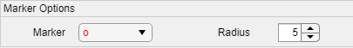
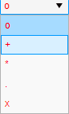
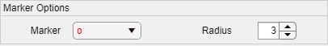
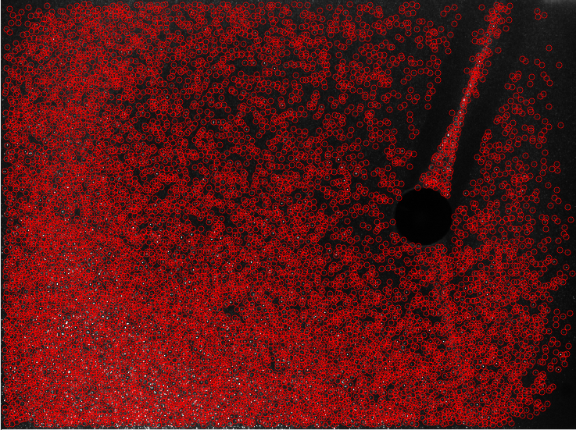
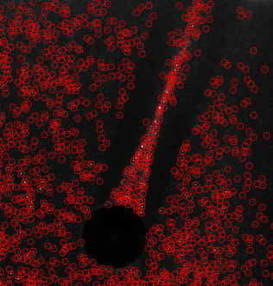
Marker Options
Marker Shape:
Changes the shape of the marker that appears on each detected pixel.
Radius:
Changes the radius of the marker.

Slide 6
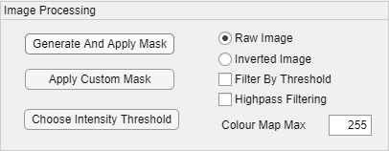
Image Pre-Processing
All of these options, with the exception of “Colour Map Max” affect the detection of particles.
Colour Map Max changes the colour map of the matlab Axes, allowing for better viewing of dim images.

Slide 7
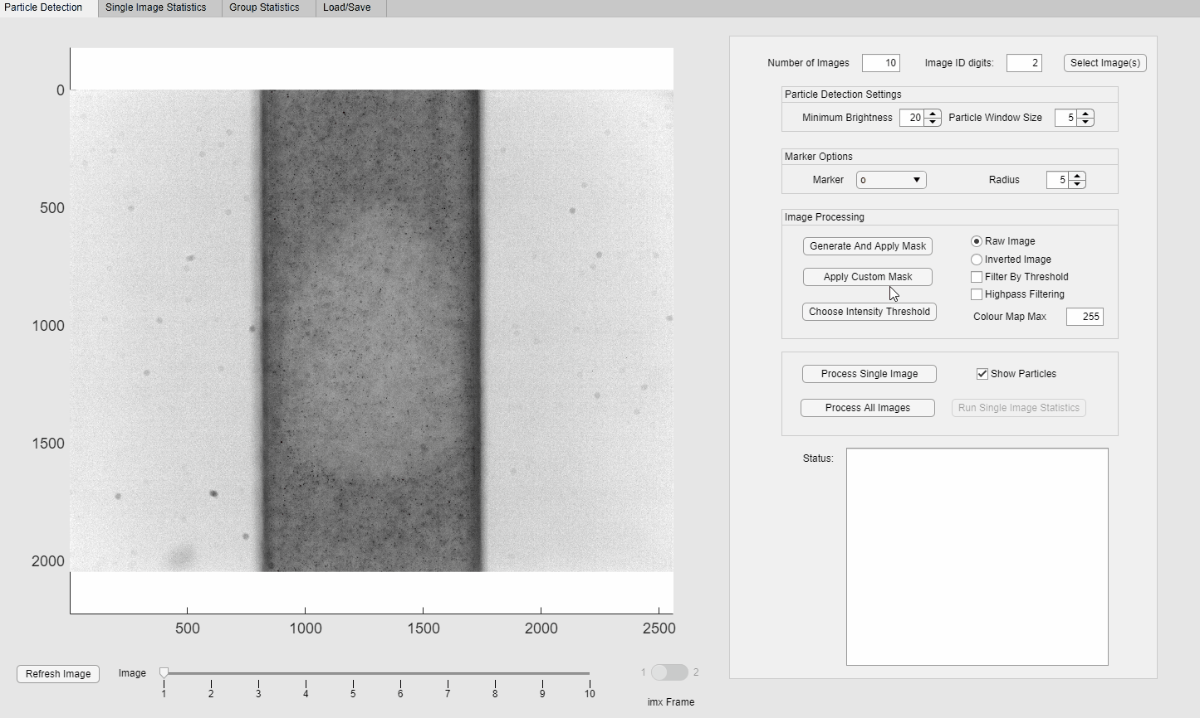
Image Pre-Processing - Masking
Generate and apply mask:
Automatically generates a mask using the pivTubeMask code.
This mask is simple and will only work for images in linear channels.
Apply Custom Mask:
Allows the user to select a premade mask for the image(s).
Note: The contrast of the image may change due to the introduction of black bars with an intensity of 0. This does not change the actual intensity of the image.

Slide 8

Image Pre-Processing - Image Inversion
Inverts all of the pixels in the image.
Useful if the particles are dark rather than bright.

Slide 9
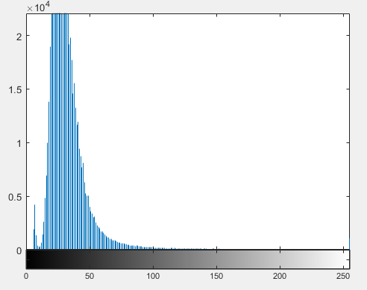
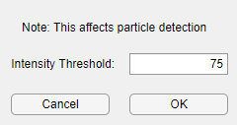
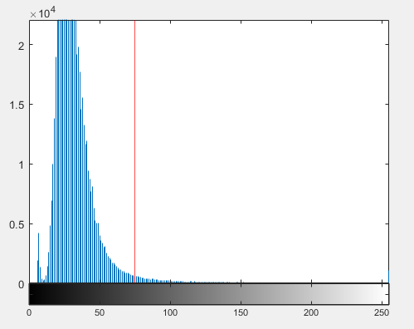
Image Pre-Processing - Intensity Threshold
Intensity Threshold:
A threshold that determines whether a pixel can be part of a particle.
Choose Intensity Threshold:
Opens up two windows.
Input custom threshold.
Image Intensity Histogram
Once a custom threshold has been set, the intensity histogram will display a red line at the thresholds value.
To revert back to default, set as 0.

Slide 10
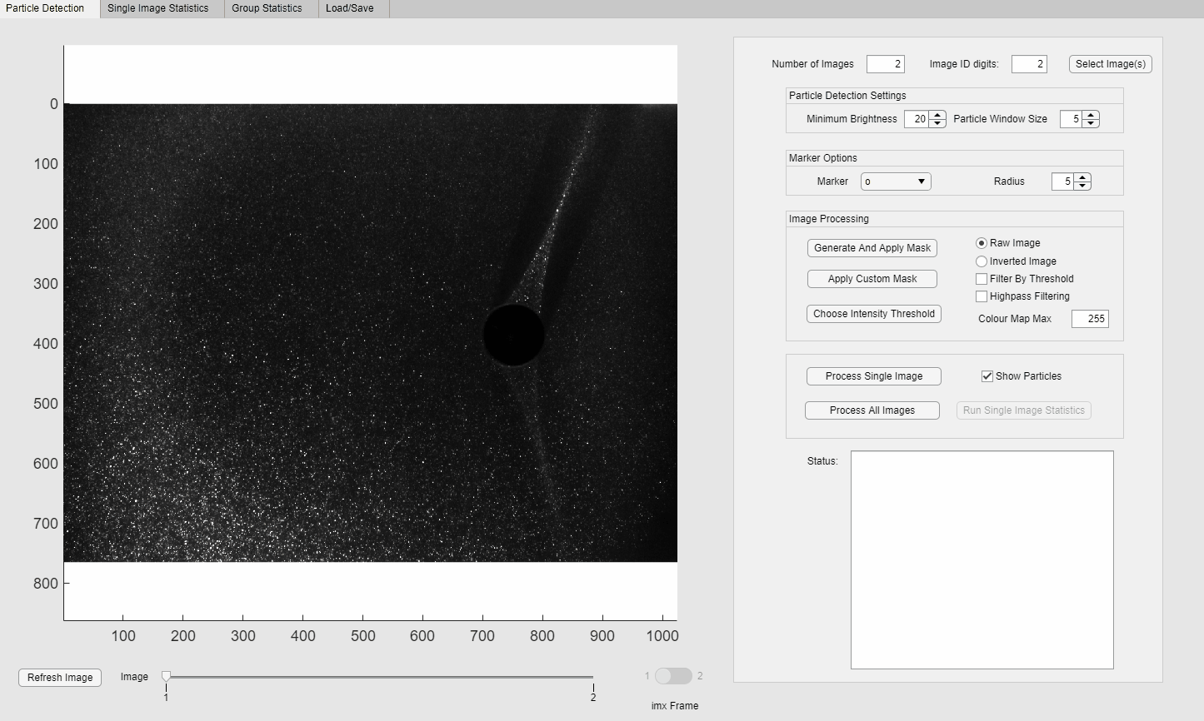
Image Pre-Processing - Filter by Intensity Threshold
Filter By Threshold: Filters the image by the custom intensity threshold, setting all pixels below that threshold to zero.

Slide 11
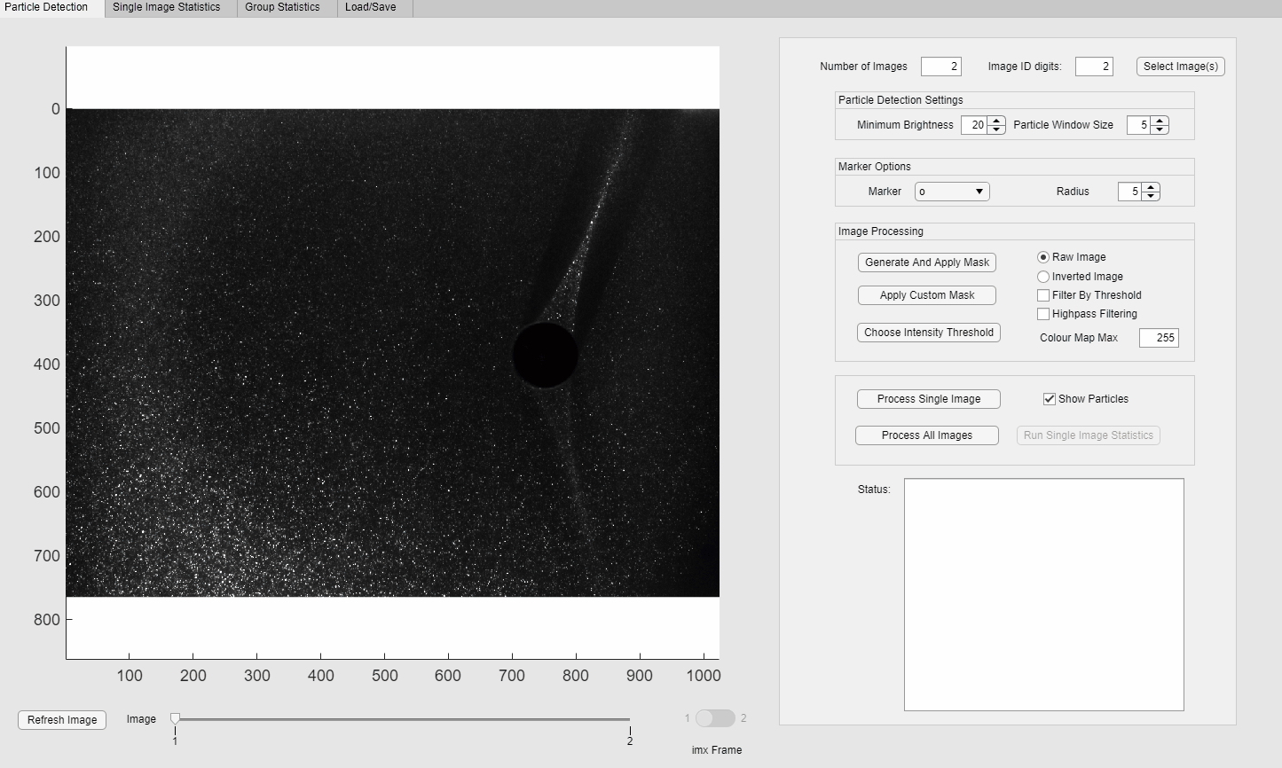
Image Pre-Processing - Highpass Filtering
Applies a highpass filter to the image.
Keeps image intensity values intact.
It is recommended to also set an intensity threshold when using this feature.

Slide 12
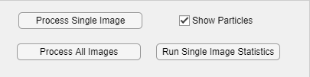
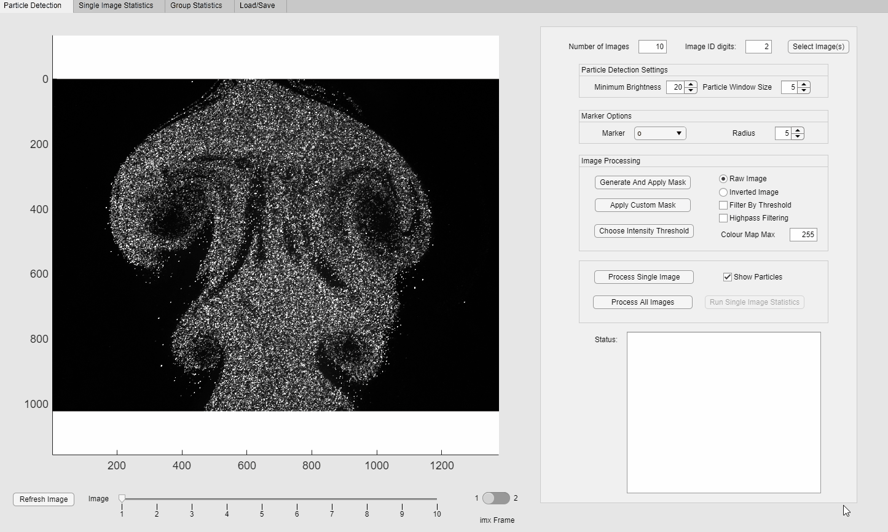
Image Processing
Process Single Image:
Processes the current selected image.
Show Particles:
Display particle markers.
Process All Images:
Processes all images in the application.
Automatically generates Group Statistics in the “Group Statistics” tab.
Run Single Image Statistics:
Generates statistics for the current image.
This image must be processed.
Processing 10 .im7 images.

Slide 13
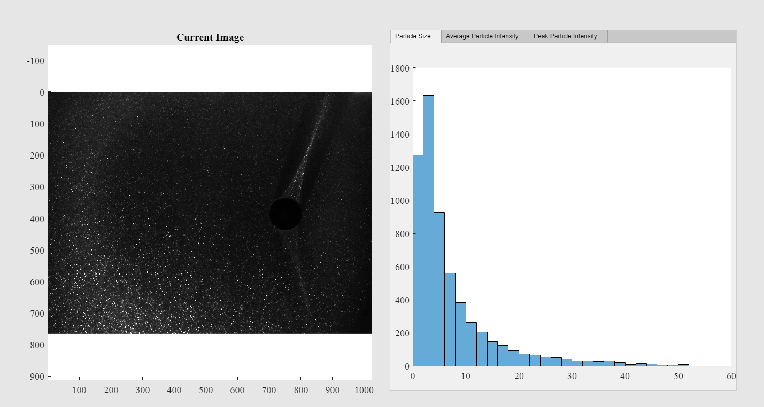
Single Image Statistics
There are three statistics given for an analyzed image:
Particle size (in total pixels).
Average particle intensity (average intensity across the particle).
Peak particle intensity (The maxima of the particle).

Slide 14
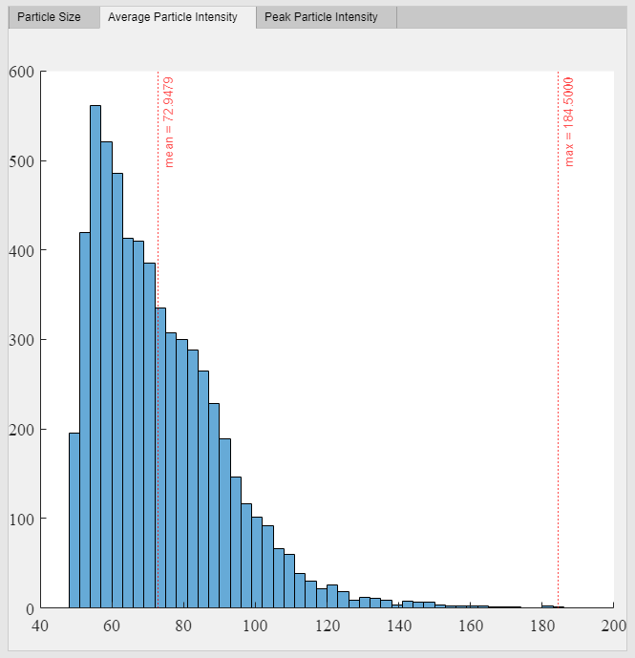
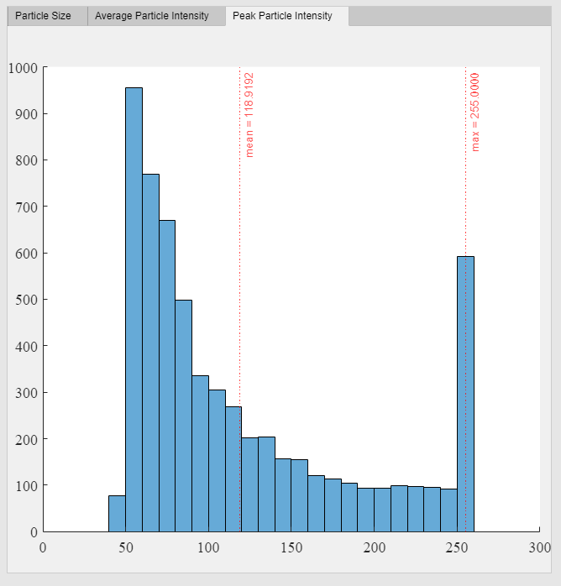
Single Image Statistics

Slide 15
Group Statistics
There are five sections in group statistics:
Number of Particles Per Image
Cumulative Particle Size
Each found particles size across all images.
Average Particle Intensity
Each particles average intensity across all images.
Peak Particle Intensity
Each particles peak intensity across all images.
Combined Statistics
Displays the average value for the four previous statistics for each individual image.
Useful in seeing trends across a data set (such as dimming of a laser, etc.).

Slide 16
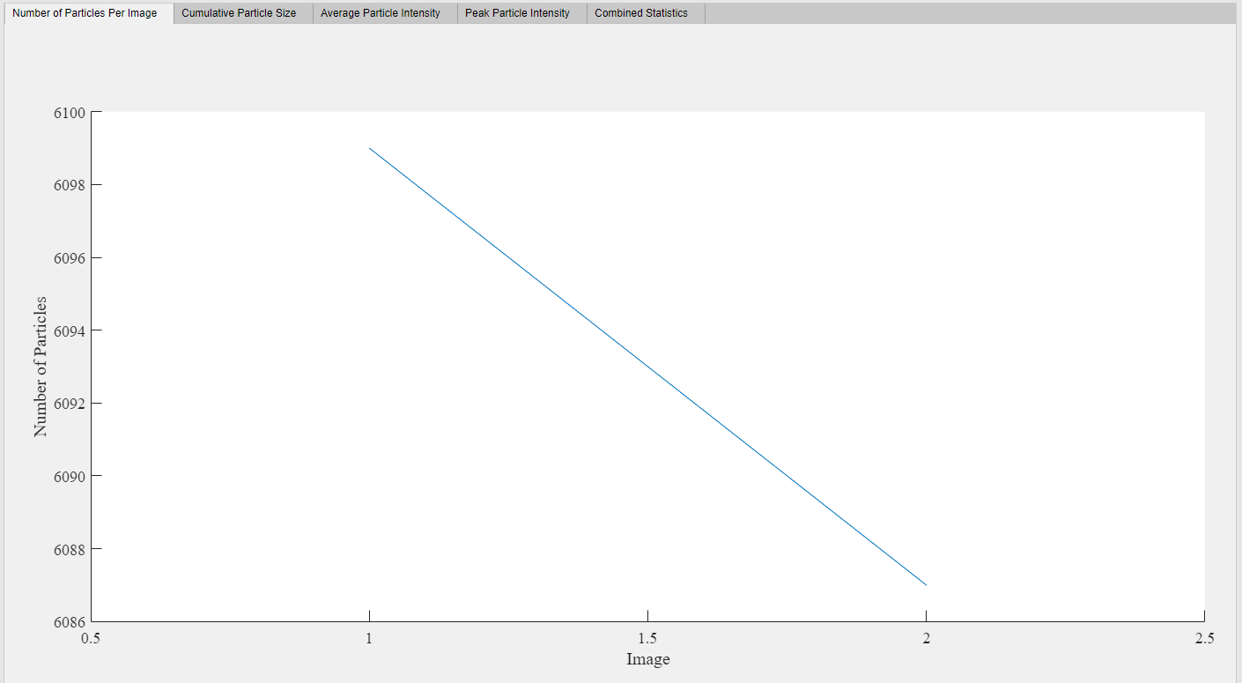
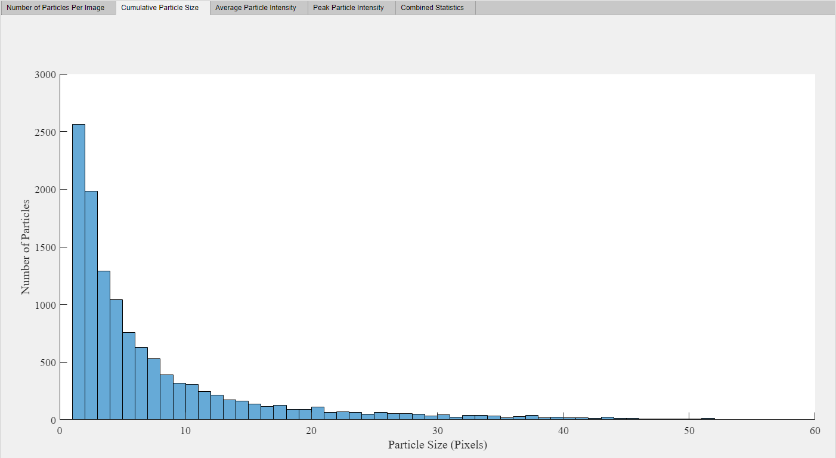
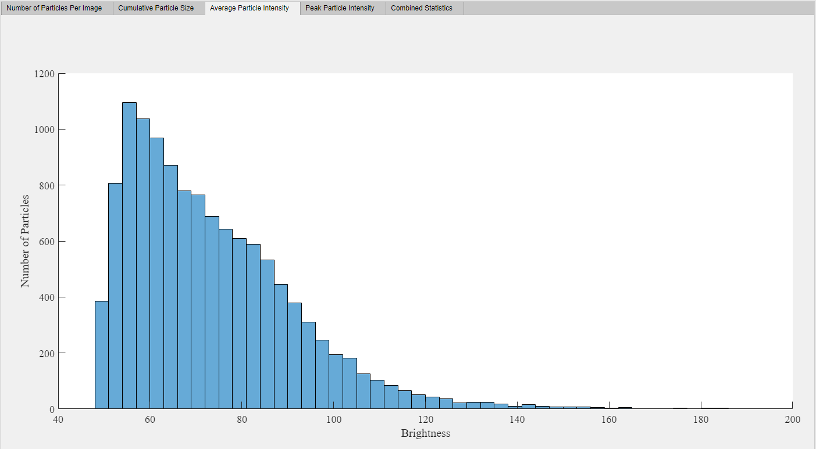
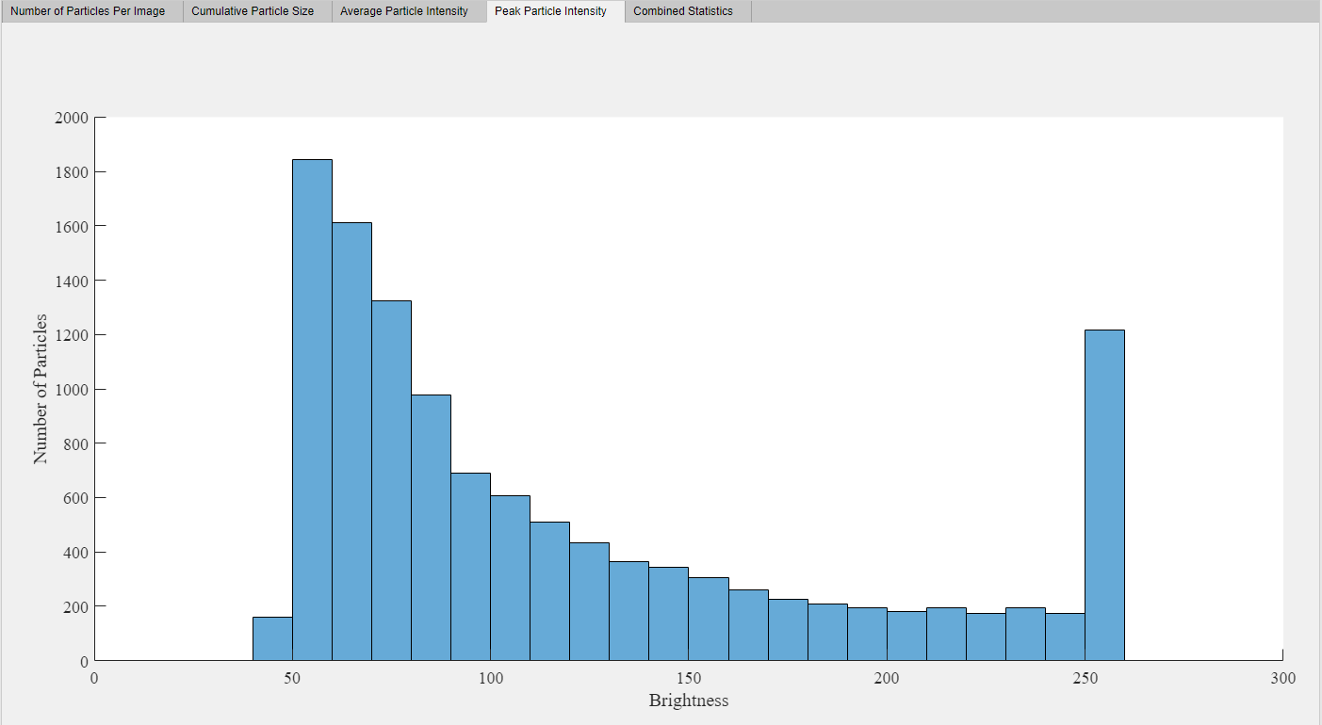

Slide 17
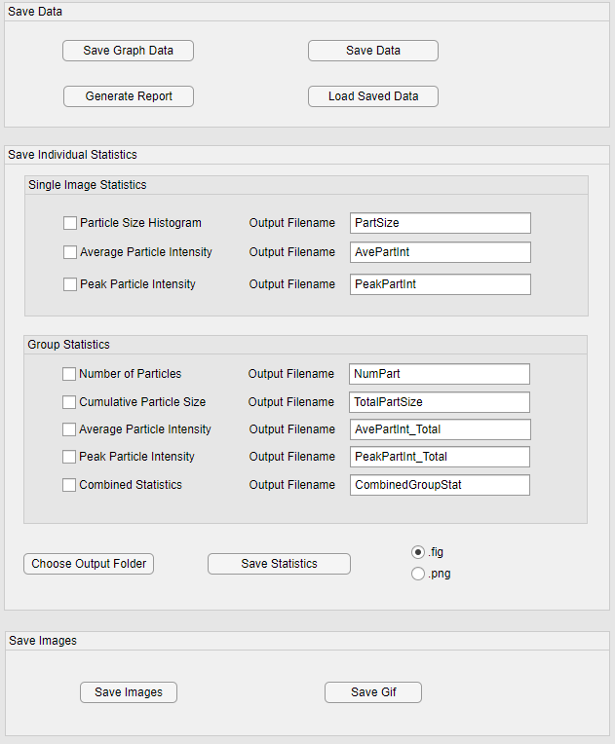
Saving Data
Save Graph Data:
Saves all data relevant to the group statistics plot, as well as particle data on each image.
Save Data:
Saves all data and settings in the app, allowing those settings and data to be loaded back in via the “Load Saved Data” button.
Generate Report:
Generates a pdf containing all plots from the group statistics section.
Save Individual Statistics Section:
Save the plots from the application into .png or .gif files.
Save Images:
Save the images as they are shown in the app as individual images or as a .gif.
Note: Preprocessing applies to these saved images.

Slide 18
Saving Data
“Save Graph Data” saves variables that are used to plot the graphs in the Group Statistics tab, as well as data on each image.
particleData: Contains data on each image in an n by 6 format. (Where n is the number of particles in the image.)
Column 1: x-coordinate
Column 2: y-coordinate
Column 3: cumulative intensity
Column 4: square of the radius of gyration
Column 5: size of particle (area in pixels)
Column 6: peak intensity

